Slide 1



PATIENT MONITORING IN AMBULANCE AND OTHER VEHICLES
GROUP - 31

Slide 2

Actual Problem
No system currently monitors patients' real-time health during hospital transport.
Lack of real-time data sharing leads to delays in preparing hospital facilities
Manual reporting by paramedics can introduce errors and delays.
Existing systems are mostly restricted to ambulances.
These issues cause delayed treatment, higher hospital load, and even loss of life.

Slide 3

Proposed Solution
Real-time Health Monitoring:
continuously measure heart rate, oxygen saturation, temperature, and GPS location.
Cloud-Based Data Transmission:
Secure transmission of patient health data to hospital systems via cloud infrastructure.
Multi-Vehicle Compatibility:
Designed for ambulances, police vehicles, rescue teams, and other emergency transport modes.
User-Friendly Interface:
Interactive dashboard for monitoring via desktop application.

Slide 4
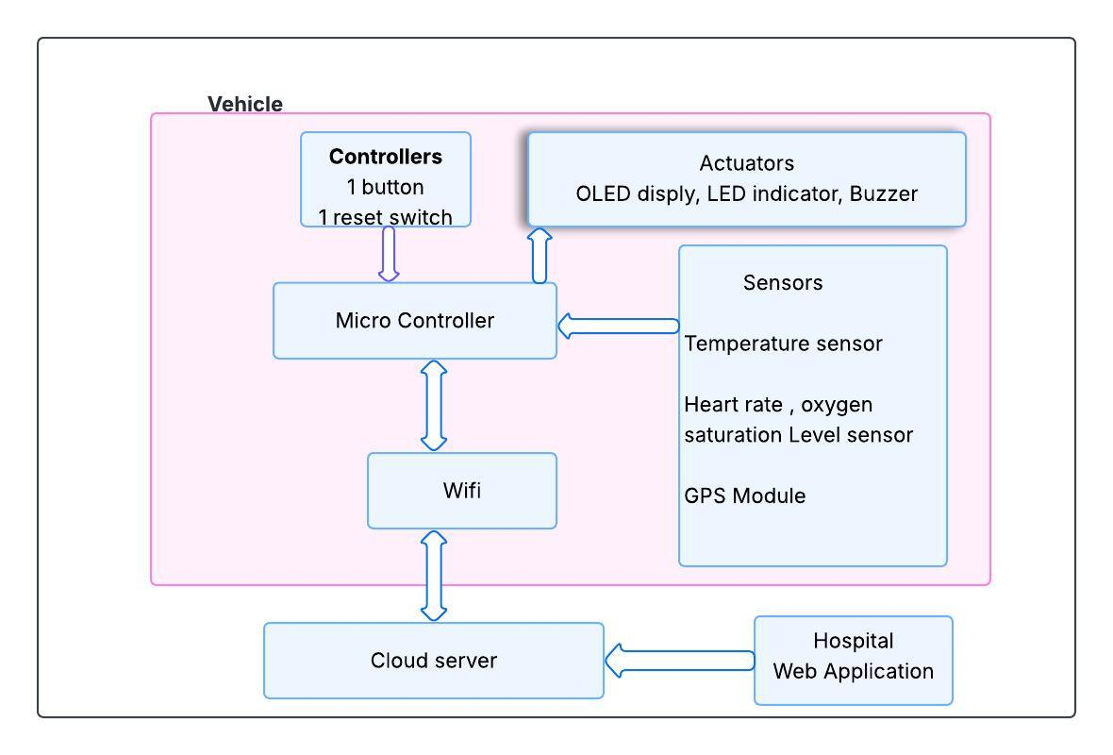
Solution Architecture
www.reallygreatsite.com

Slide 5
TECHNOLOGY STACK
Services
01
A hardware device developed with ESP-IDF and C programming.
02
Web application created using Html , CSS and Javascript.
03
MQTT protocol to communicate with the thing in IoT core and in there these messages are handled by MQTT message broker
04

Slide 6

Used Protocols
MQTT
MQTT is a lightweight, publish-subscribe messaging protocol, ideal for low-bandwidth and real-time communication.
I2C
It is a synchronous, multi-master, multi-slave serial communication protocol that uses two lines (SDA and SCL) to exchange data.
UART
UART is a serial communication protocol, enables asynchronous data exchange between devices using just two wires.

Slide 7
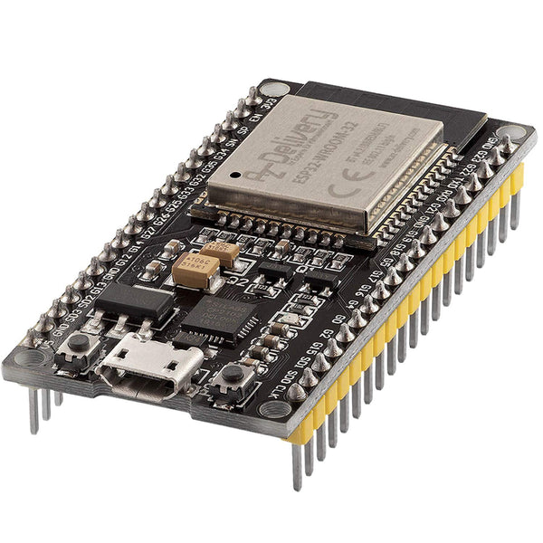
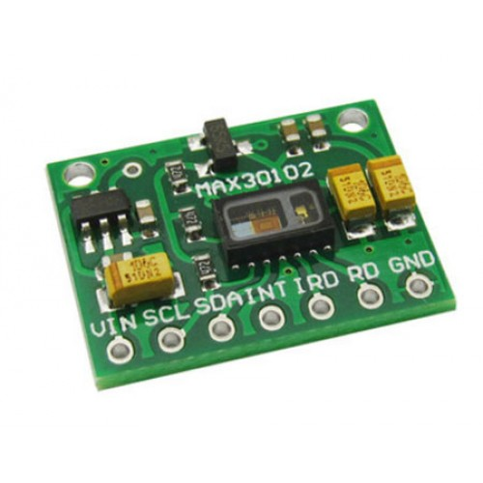
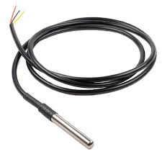
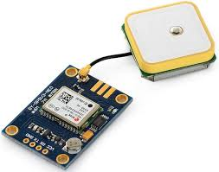
Hardware
ESP32
Max30102 sensor
ds18b20 temperature sensor
Neo6m Gps Module

Slide 8
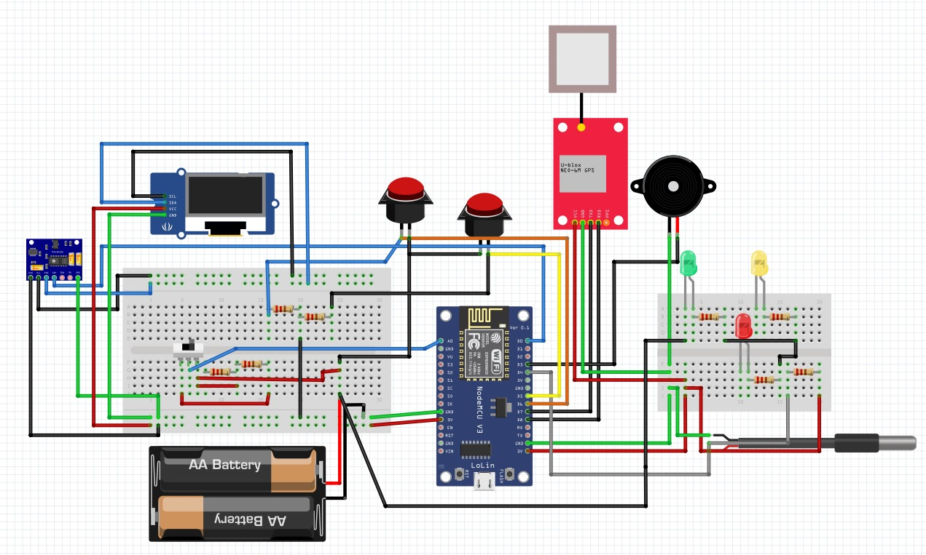
Circuit Diagram
www.reallygreatsite.com

Slide 9
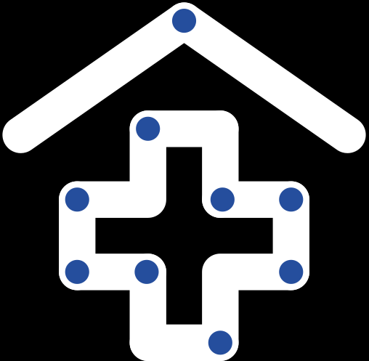
Challenges
Sensor Integration & Accuracy
Calibrating sensors (temperature, heart rate, SpO₂) for reliable real-time readings.
Real-Time Data Transmission
Ensuring stable communication for continuous data flow.
Power Management
Optimizing power usage to support long-term monitoring in mobile environments.

Slide 10
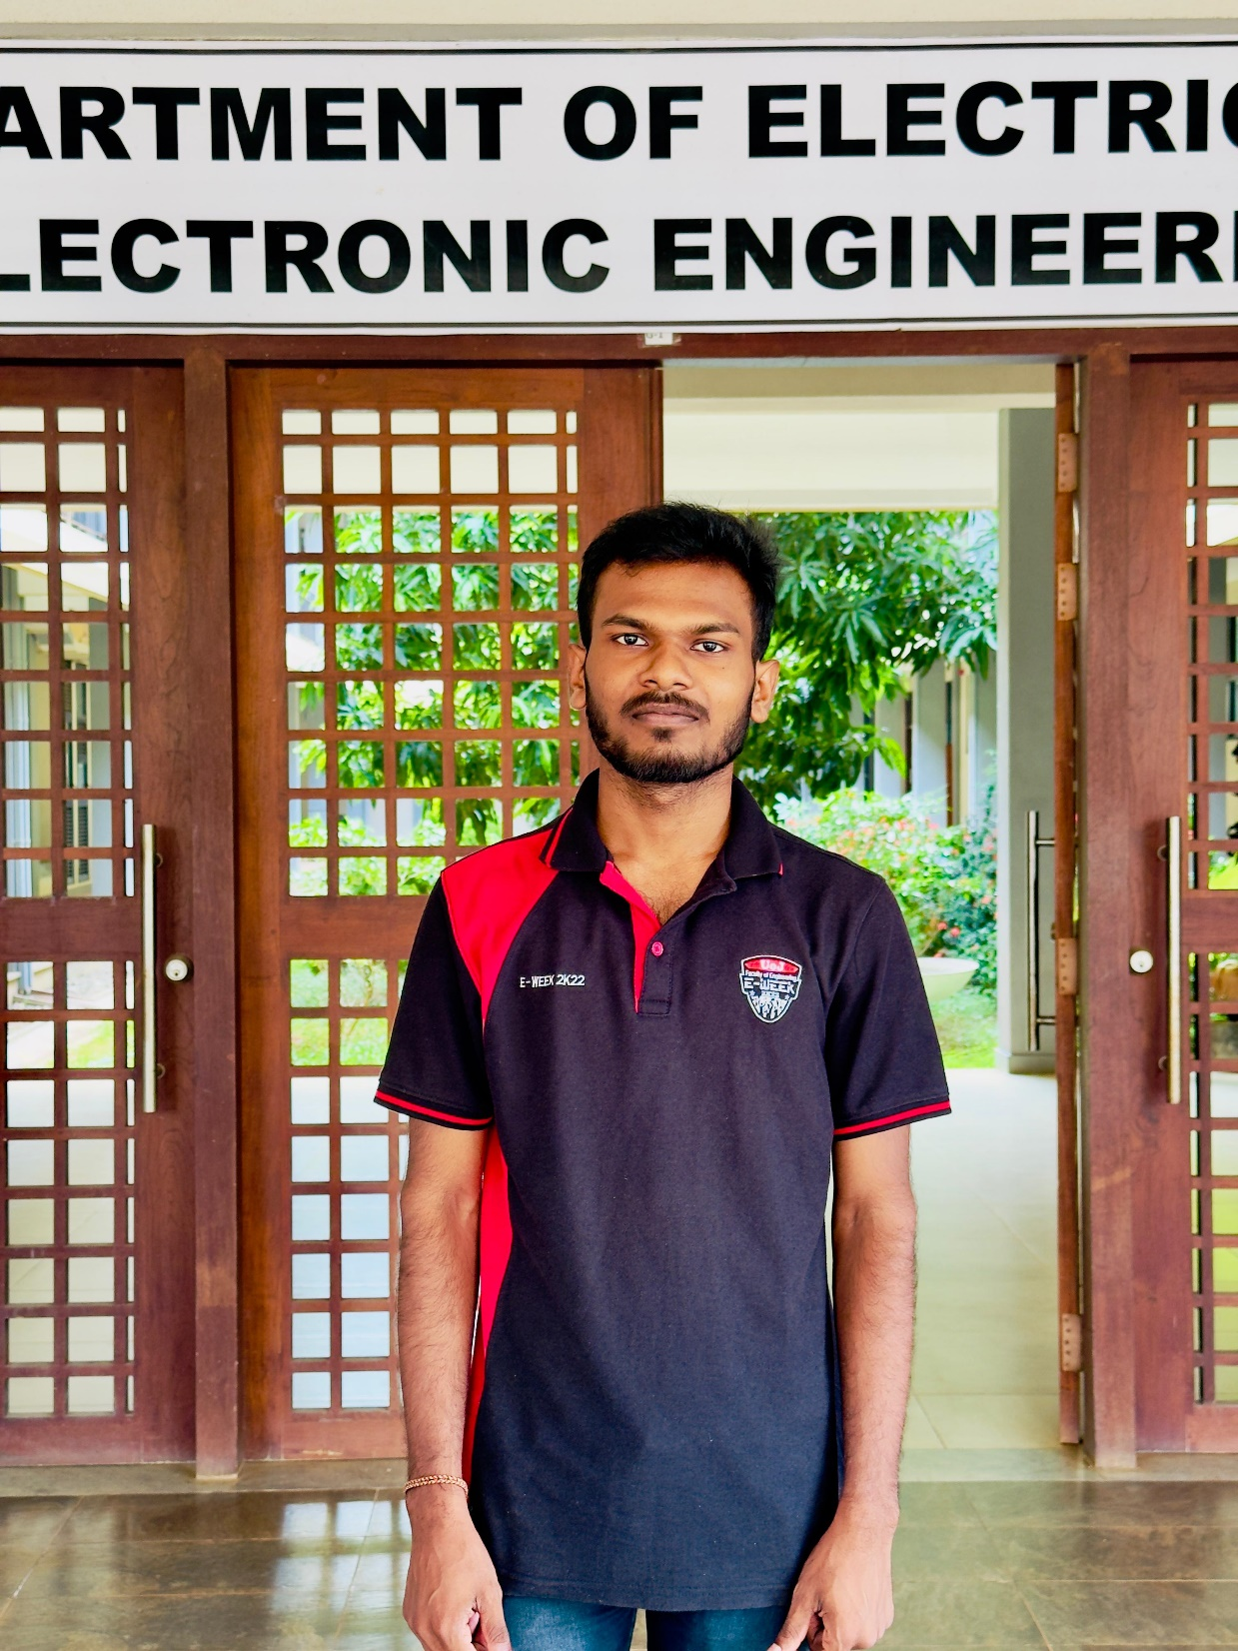
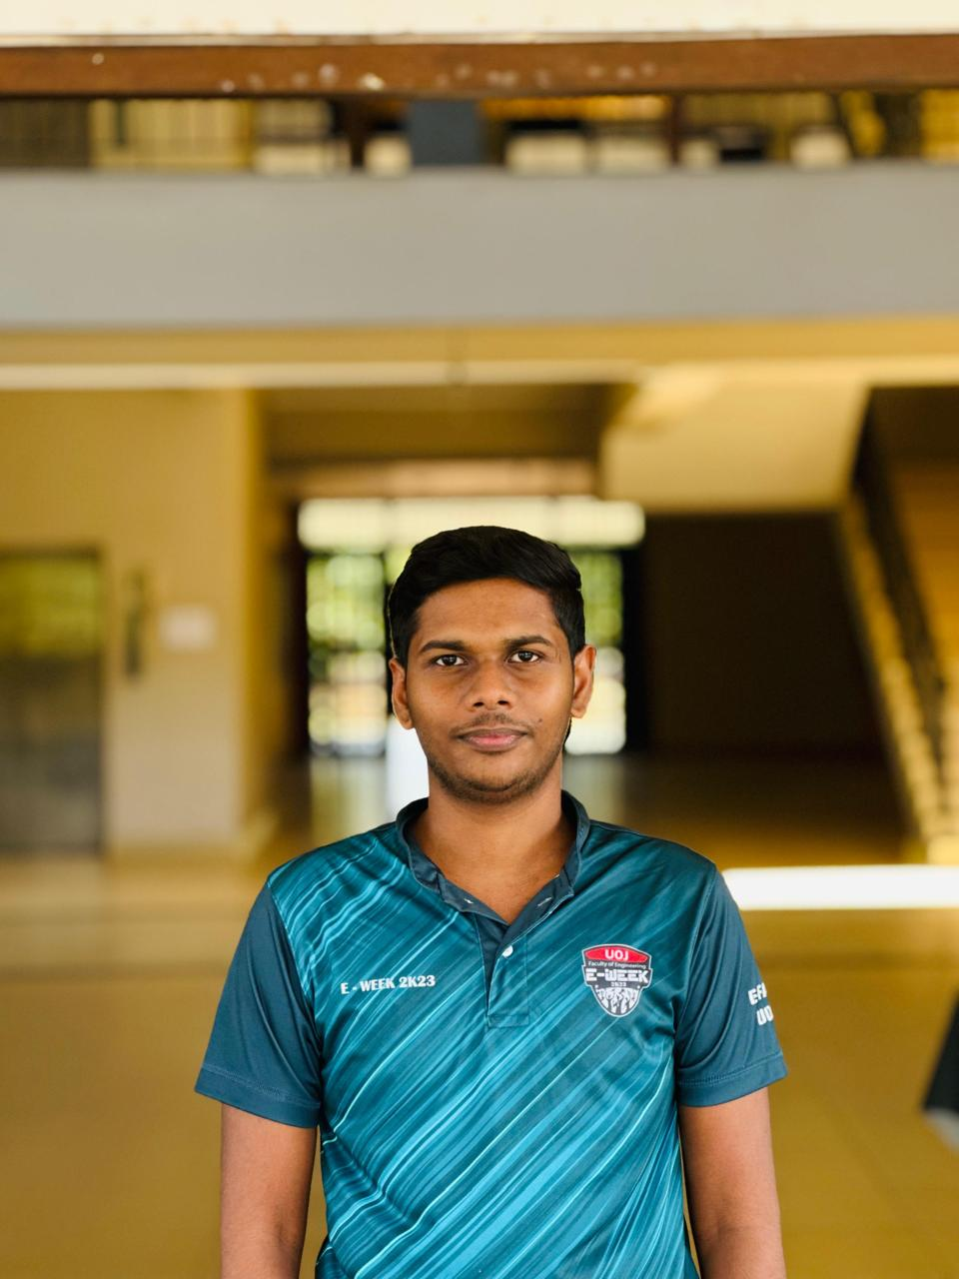

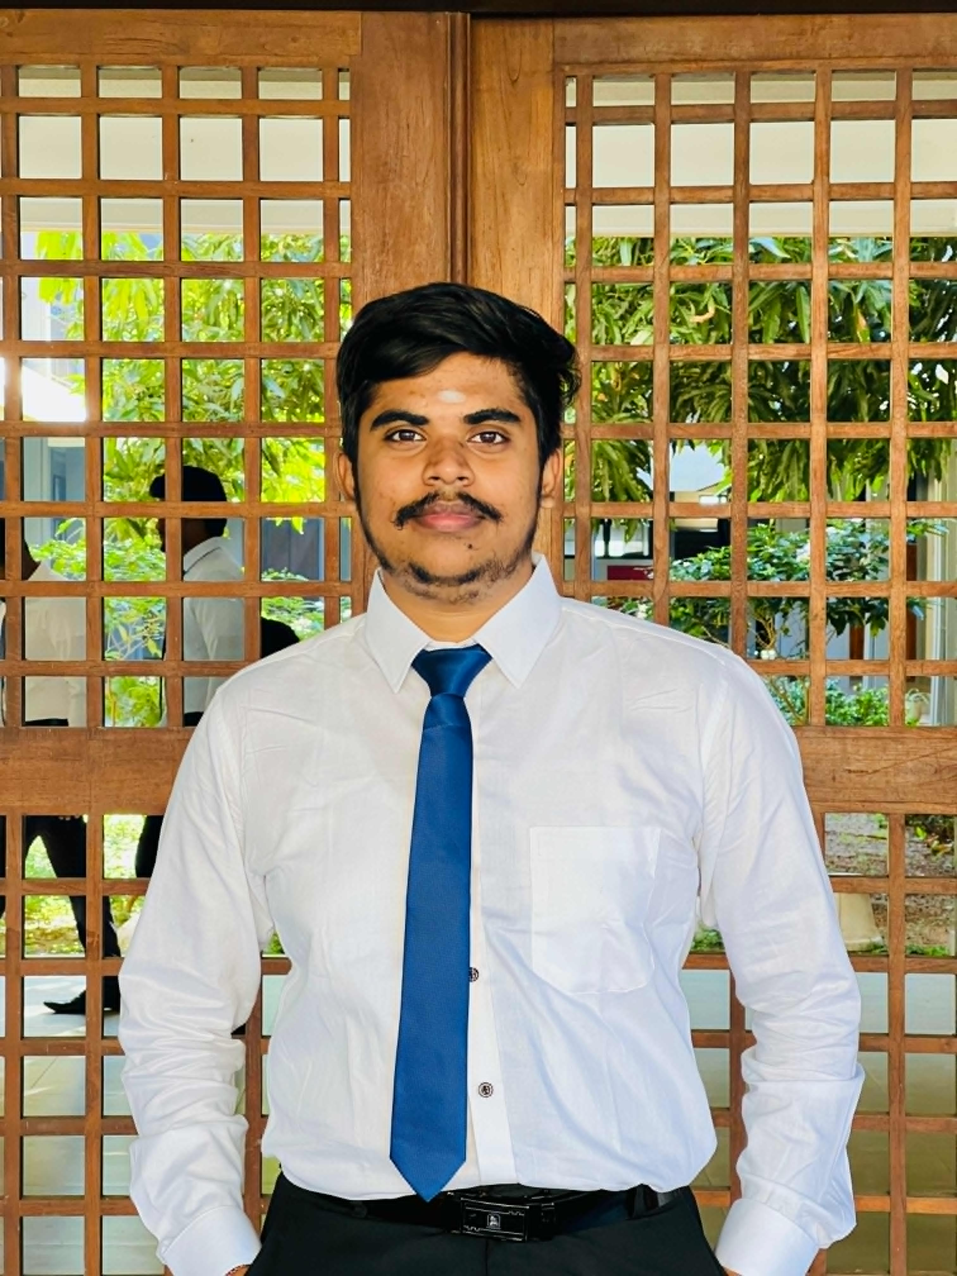
Team – GROUP 31
K.Vashiharan
2021/E/074
T.Sarujan 2021/E/164
V.Vithushikan
2021/E/169
R.Nidhushan
2021/E/189

Slide 11
Thank
You

